Slide 1
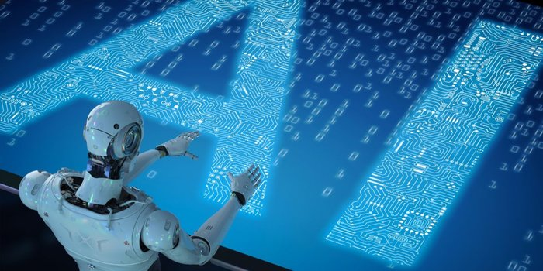

Artificial Intelligence Champion Course

Slide 2
Course Overview
Learning Objectives
Becoming an Artificial Intelligence Engineer puts you on the path to an exciting, evolving career that is predicted to grow sharply into 2020 and beyond. Artificial intelligence will impact all segments of daily life by 2025, with applications in a wide range of industries such as healthcare, transportation, insurance, transport and logistics and even customer service.
Current AI Market Trend
The New York Times reports a candidate shortage for certified AI Engineers, with fewer than 10,000 qualified people in the world to fill these jobs, which according to that, an average salary of $172,000 per year in the U.S. for engineers with the required skills.
Skills you will learn
Design and build your own intelligent agents and apply them to create practical machine learning models, logic constraint satisfaction problems, knowledge-base systems, probabilistic models.
Understand and master the concepts and principles of machine learning, including its mathematical and heuristic aspects.
Implement deep learning algorithms in keras backend with TensorFlow.
Understand neural networks, empowering you to analyse and utilize data in a better way.
Master advanced topics such as convolutional neural networks, recurrent neural networks, training deep networks and high-level interfaces
Learn about major applications of Artificial Intelligence across various use cases in various fields like customer service, financial services, healthcare etc.,
Ability to apply Artificial Intelligence techniques for problem-solving and explain the limitations of current A I techniques

Slide 3
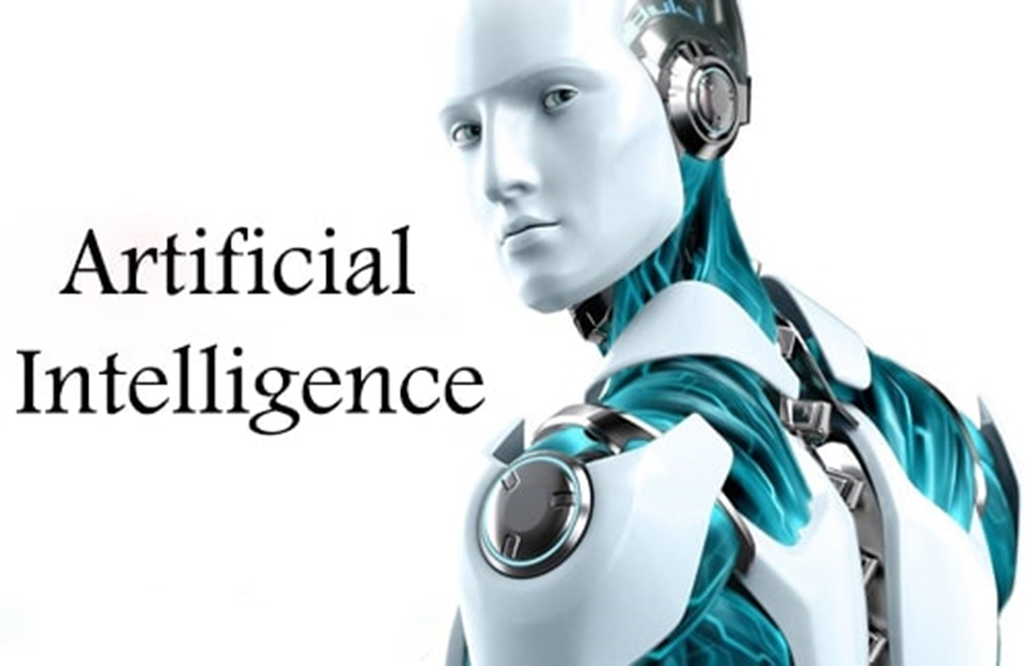

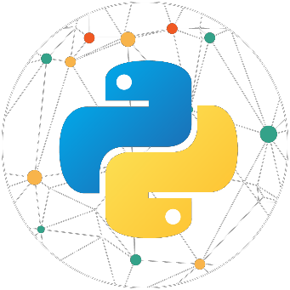

Course Coverage
Artificial Intelligence
Deep Learning
Statistics for Data Science
Machine Learning
Python

Slide 4
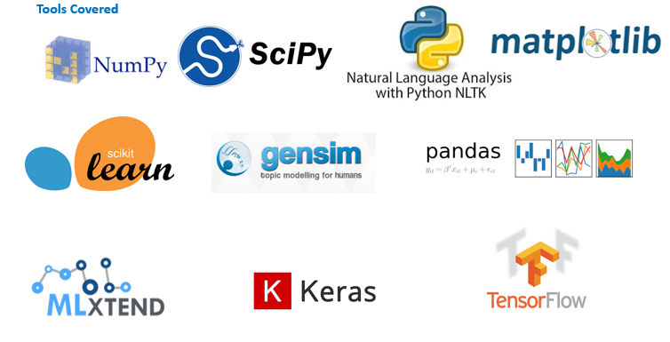
Tools Coverage

Slide 5
1. Artificial Intelligence Overview

Slide 6



Course Outline
Introduction to Python
Functions, Modules & Packages
Understanding the Data
Testing the Data
Basics of Python
OOPs & Exception Handling
File Handling
Probability & it’s Usage
Data Clustering
String Manipulation
Numpy, Pandas, Matplotlib, SciPy
List Manipulation
Database
Statistical Inference
Regression Modelling
Tuple, Set Manipulation
Networking & Multithreading
Dictionaries Manipulation
Web Python

Slide 7
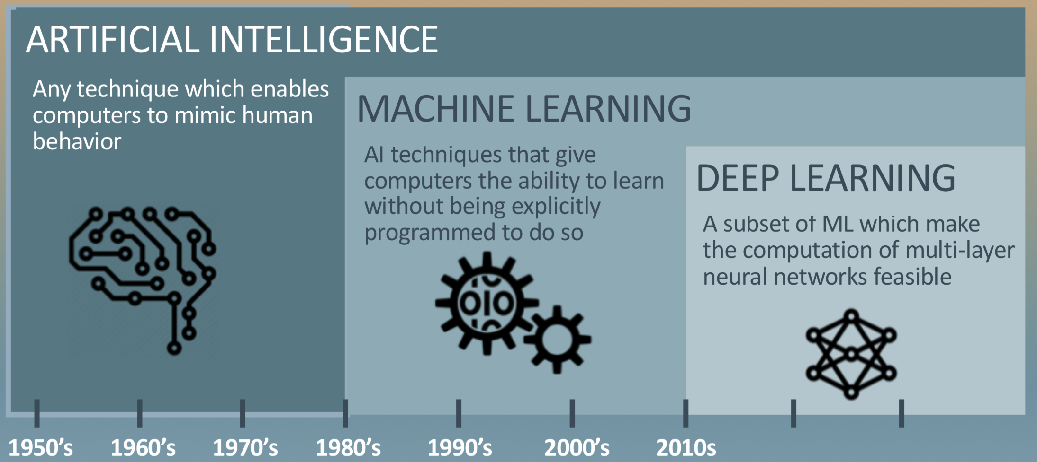
Course Outline
Introduction to Python
Functions, Modules & Packages
Understanding the Data
Testing the Data
Basics of Python
OOPs & Exception Handling
File Handling
Probability & it’s Usage
Data Clustering
String Manipulation
Numpy, Pandas, Matplotlib, SciPy
List Manipulation
Database
Statistical Inference
Regression Modelling
Tuple, Set Manipulation
Networking & Multithreading
Dictionaries Manipulation
Web Python

Slide 8
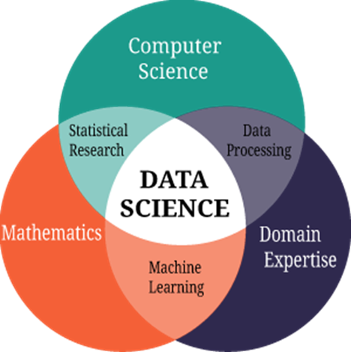

2. Statistics for Data Science

Slide 9

Statistics for Data Science
Objective 01
Make you analyze different types of data & test the data
Help you understand sampling techniques and Probability concepts
Objective 02
Objective 03
Explain you the basis of Inferential
Statistics
Make you understand Regression and
Clustering concepts
Objective 04

Slide 10
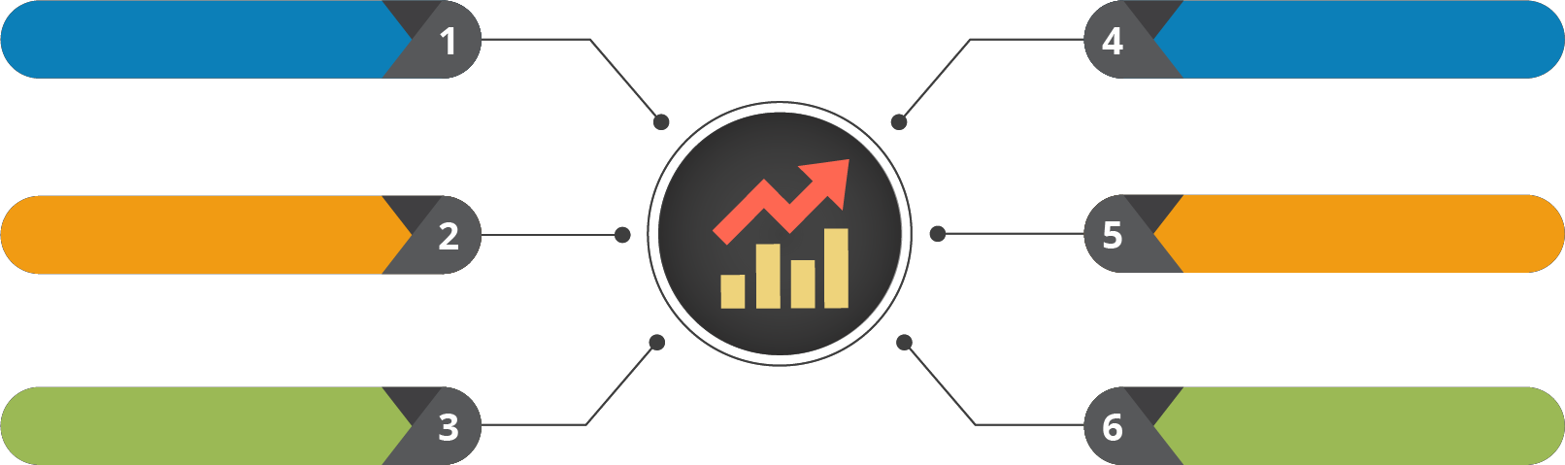
Course Outline
Introduction to Python
Functions, Modules & Packages
Understanding the Data
Testing the Data
Basics of Python
OOPs & Exception Handling
File Handling
Probability & it’s Usage
Data Clustering
String Manipulation
Numpy, Pandas, Matplotlib, SciPy
List Manipulation
Database
Statistical Inference
Regression Modelling
Tuple, Set Manipulation
Networking & Multithreading
Dictionaries Manipulation
Web Python

Slide 11
3. Python Champion

Slide 12







Python Champion
Objective 1
To make you write python
scripts, unit test code
01
Objective 2
To make you analyze and
download data programmatically
02
03
Objective 3
Make you learn techniques to
deal with different types of data
– Ordinal, Categorical, Encoding
04
Objective 4
Learn Data Visualization
using Numpy, Pandas,
Matplotlib

Slide 13
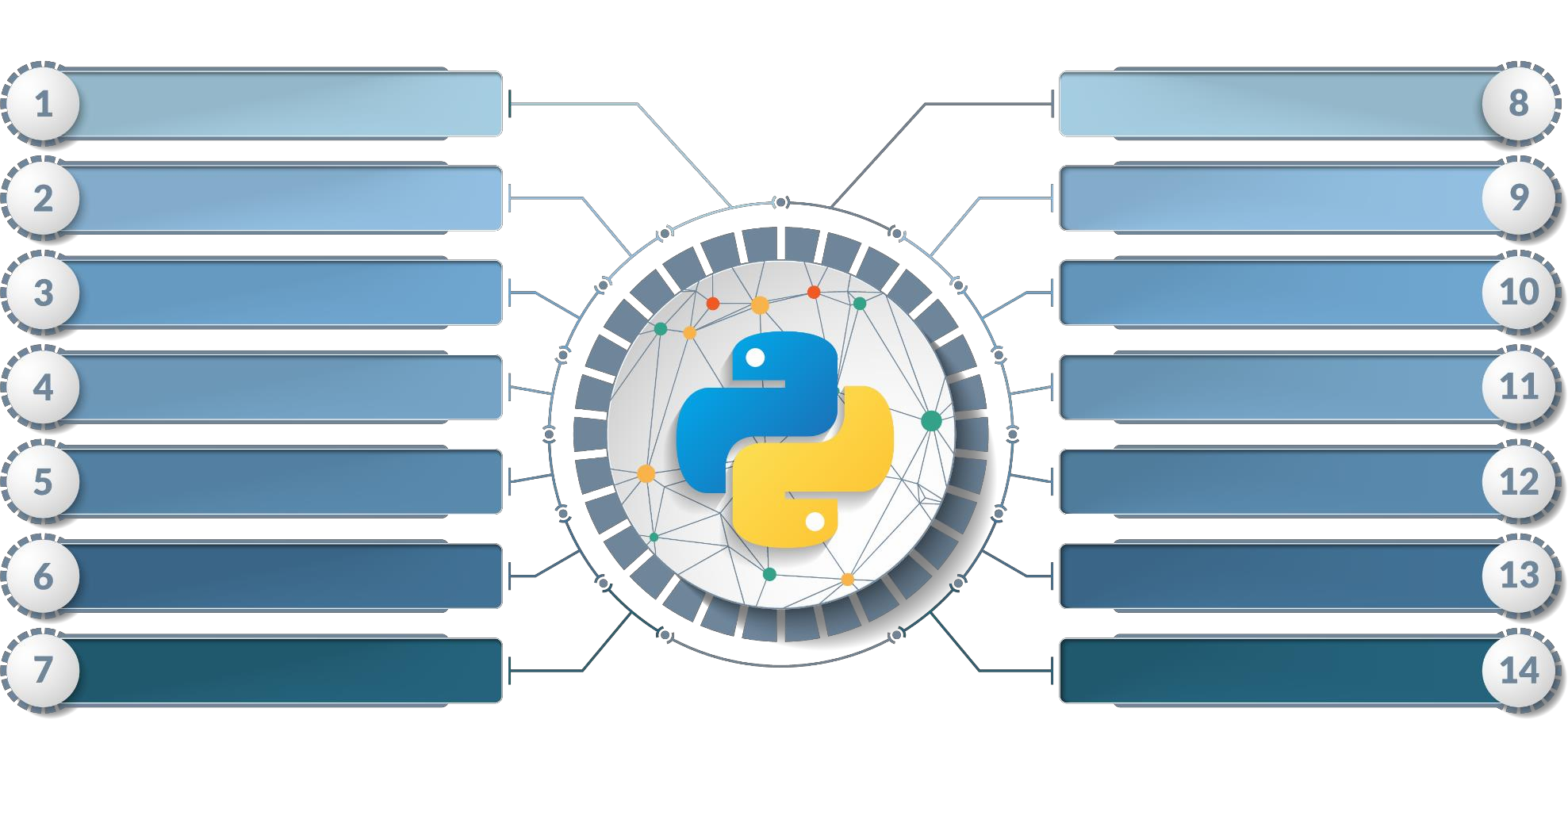
Course Outline
N
Introduction to Python
Functions, Modules & Packages
Basics of Python
OOPs & Exception Handling
Program Flow Control
File Handling
String Manipulation
Numpy, Pandas, Matplotlib, SciPy
List Manipulation
Database
Tuple, Set Manipulation
Networking & Multithreading
Dictionaries Manipulation
Web Python

Slide 14
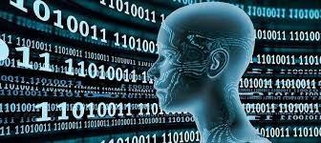
4. Machine Learning Champion

Slide 15

Machine Learning using Python
Objective 1
Data Wrangling, Scikit-Learn, Linear
Regression, Overfitting, Underfitting,
Logisitic Regression
Objective 2
Decision Tree, Random Forest,
Confusion Matrix, PCA, LDA, Scaling, Naive Bayes, SVM
01
02
03
Objective 3
Recommendation Engines,
Market Basket Analysis, Appriori
Algorithm, Q Learning, MDP
04
Objective 4
ARIMA, Stationarity, ACF,
PACF, Cross Validation,
Boosting

Slide 16
Course Outline
Course Outline
Introduction to Python
Functions, Modules & Packages
Introduction to Python
Dimensionality Reduction
Sequences and File Operations
OOPs & Exception Handling
Basics of Python
Supervised Learning - II
Deep Dive-Functions, OOPS, Modules, Errors and Exceptions
Program Flow Control
File Handling
Unsupervised Learning
Introduction to Numpy, Pandas and Matplotlib
Association Rules Mining and Recommendation Systems
String Manipulation
Numpy, Pandas, Matplotlib, SciPy
List Manipulation
Database
Data Manipulation
Reinforcement Learning
Introduction to Machine Learning with Python
Tuple, Set Manipulation
Networking & Multithreading
Time Series Analysis
Dictionaries Manipulation
Web Python
Supervised Learning - I
Model Selection and Boosting

Slide 17
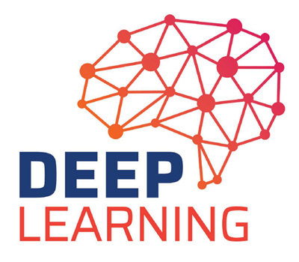
5. Deep Learning Champion

Slide 18

Deep Learning with TensorFlow
01
Objective 01
Explain and Train Neural Networks
02
Objective 02
Implement ANN, CNN and RNN
03
Objective 03
Discuss Backpropagation
04
Objective 04
Create LSTMs and Autoencoder Neural Network
architectures.

Slide 19
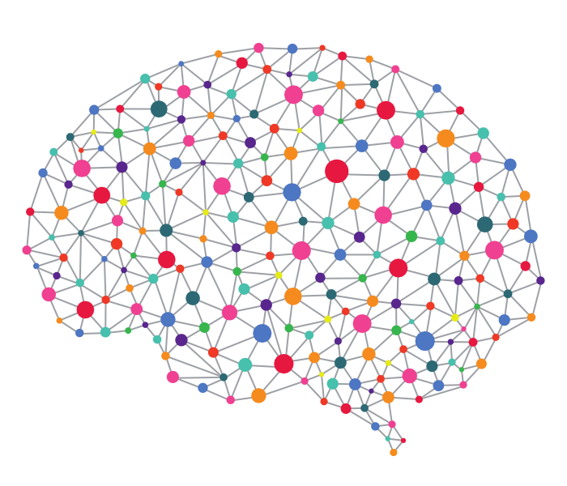

Course Outline
Module
Introduction to Deep Learning
Module
Recurrent Neural Networks
1
6
Module
Understanding Neural Networks with Tensorflow
Module
RBM and Autoencoders
2
7
Module
Deep dive into Neural Networks
with Tensorflow
Module
Keras
3
8
Module
Master Deep Networks
Module
TFlearn
4
9
Module
Convolutional Neural Networks
Module
Hands-On Project
5
10

Slide 20
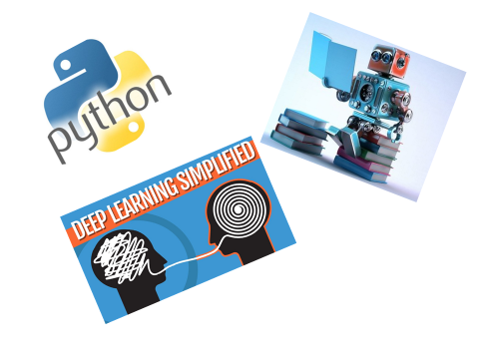
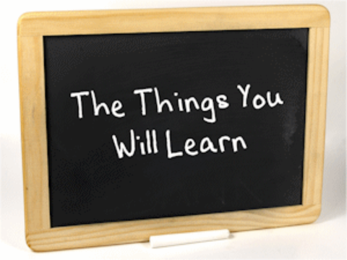
Course Summary

Slide 21



Copyright © 2017, edureka and/or its affiliates. All rights reserved.

Slide 22
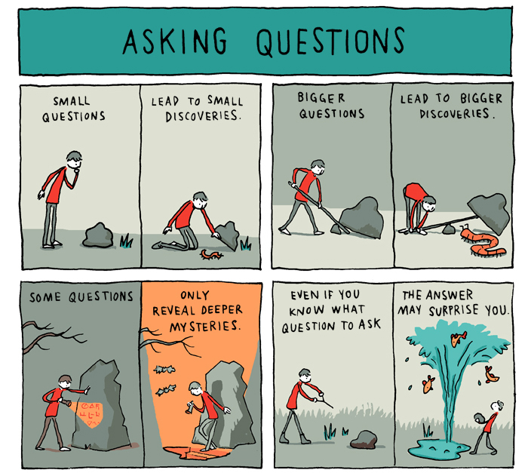

Slide 23
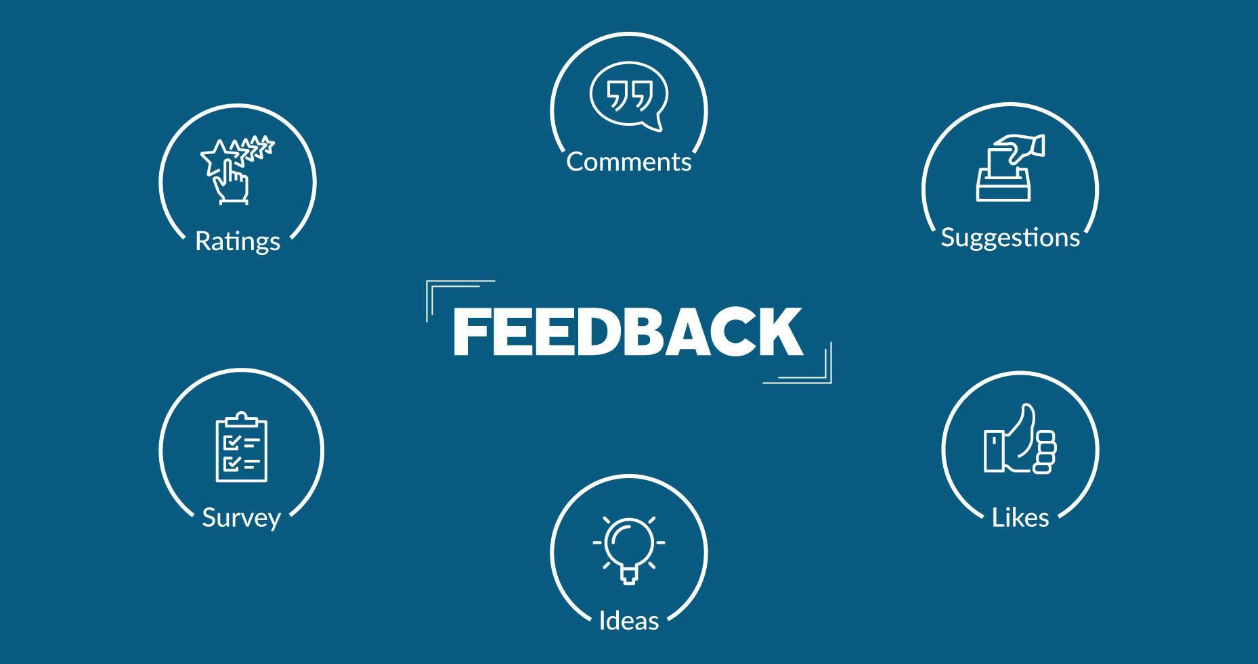
Copyright © 2017, edureka and/or its affiliates. All rights reserved.

Slide 24


